Slide 1
PARKINSON DISEASE DETECTION USING MACHINE LEARNING
WHERE IMAGES ARE USED AS DATA SET AND IT IS USED AS INPUTS.
Notes:
START WITH A SHORT STORY WHY WE ARE USING AI ??

Slide 2
WHAT IS PARKINSON DISEASE ?
Parkinson disease is a brain disorder that leads to shaking, stiffness, difficulty with walking.
This may get or effected through Genetics.
There are 5 stages of Parkinson’s disease.

Slide 3
SYMPTOMS OF PARKINSON DISEASE:
TREMOR
MUSCULAR
SLEEPING DISORDERS
WHOLE BODY
COGNITIVE
NASAL
URINARY
Notes:
BASED ON ABOVE SYMPTOMS HOSPTITALS CAN DETECT PARKINSON DISEASE:

Slide 4
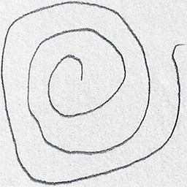
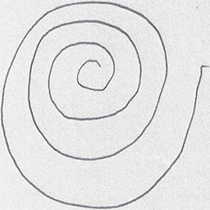
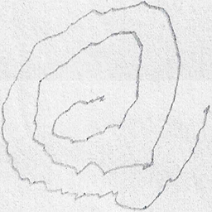
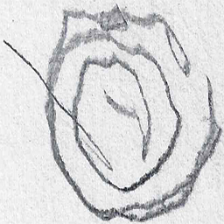
INPUTS OF THIS MODEL:
Notes:
THESE ARE THE IMAGE INPUTS, THESE ARE COLLECTED FROM VARIOUS RESOURCES.

Slide 5
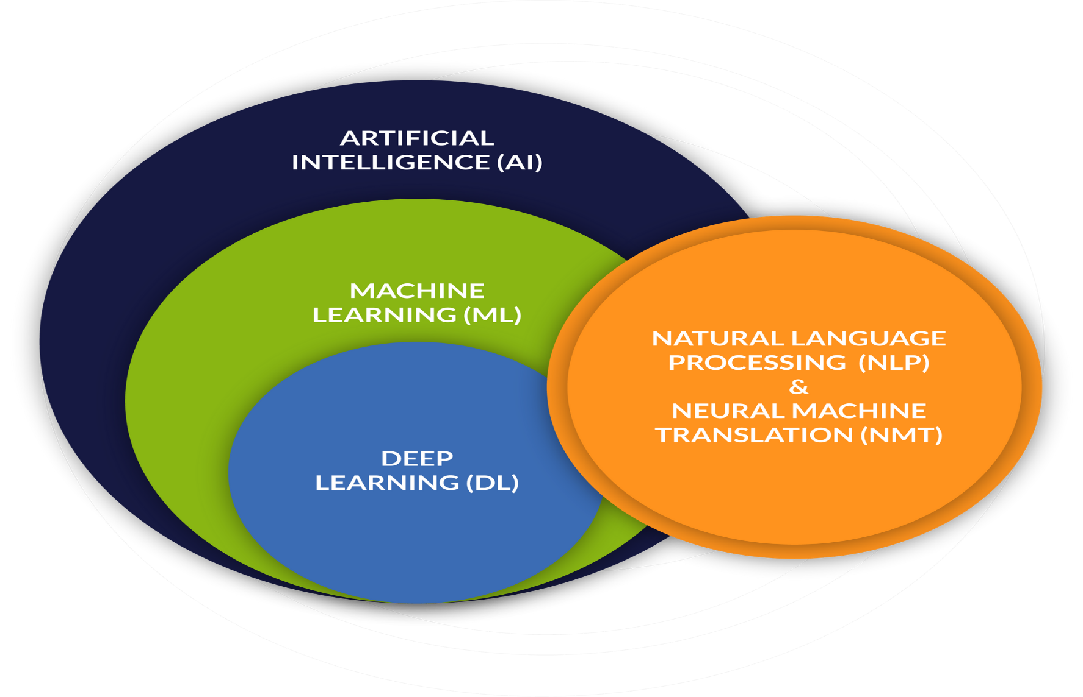
Why we are choosing AI ??

Slide 6
WHAT IS MACHINE LEARNING ?
The study of computer algorithms that can improve automatically through experience and by the use of data.
Term was coined by Arthur Samuel in 1959.
It builds the model based on data called Training data.
No in depth programming is required to learn Machine Learning.

Slide 7
TYPES OF MACHINE LEARNING:
SUPERVISED MACHINE LEARNING
UNSUPERVISED MACHINE LEARNING
REINFORCEMENT MACHINE LEARNING

Slide 8
MACHINE
LEARNING
ALGORITHMS
SUPERVISED
LEARNING
CLASSIFICATION
REGRESSION
UNSUPERVISED
LEARNING
CLUSTERING

Slide 9
PROGRAMMING LANGUAGES USED IN ML:
PYTHON
R STUDIO

Slide 10
LIFE CYCLE OF ML/STEPS INVOLVED IN ML:
COLLECTION OF DATA
PREPARING THE DATA OR DATA PRE-PROCESSING
SPLITTING THE DATA IN TRAINING AND TESTING DATA.
CHOOSING THE MODEL
MEASURING ACCURACY
SAVING THE MODEL
DEPLOYEMENT

Slide 11
WHY I CHOOSE RANDOM FOREST ALGORITHM ONLY ?
BEST ACCURACY AMONG ALL ALGORITHMS
NO NEED OF HYPER PARAMETER TUNING.
TAKES LESS TRAINING TIME THAN OTHER ML ALGORITHMS.
FLEXIBLE
EASY TO USE.
IT IS USED BECAUSE OUR DATA IS CLASSIFICATION TYPE.

Slide 12
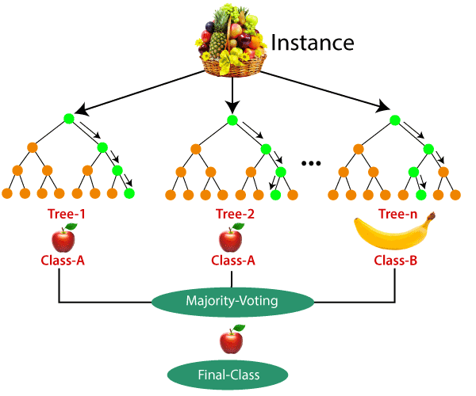
RANDOM FOREST CLASSIFIER:
IT IS A CLASSIFIER WHERE IT CONTAINS NUMBER OF DECISION TREES ON VARIOUS SUBSETS OF A GIVEN DATA SET.

Slide 13
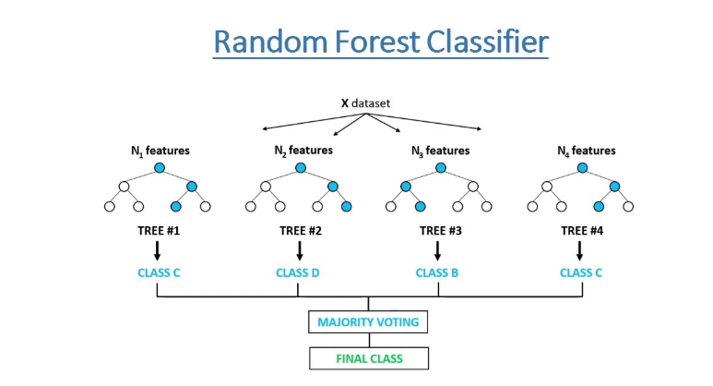
RANDOM FOREST CLASSIFIER ALGORITHM:

Slide 14
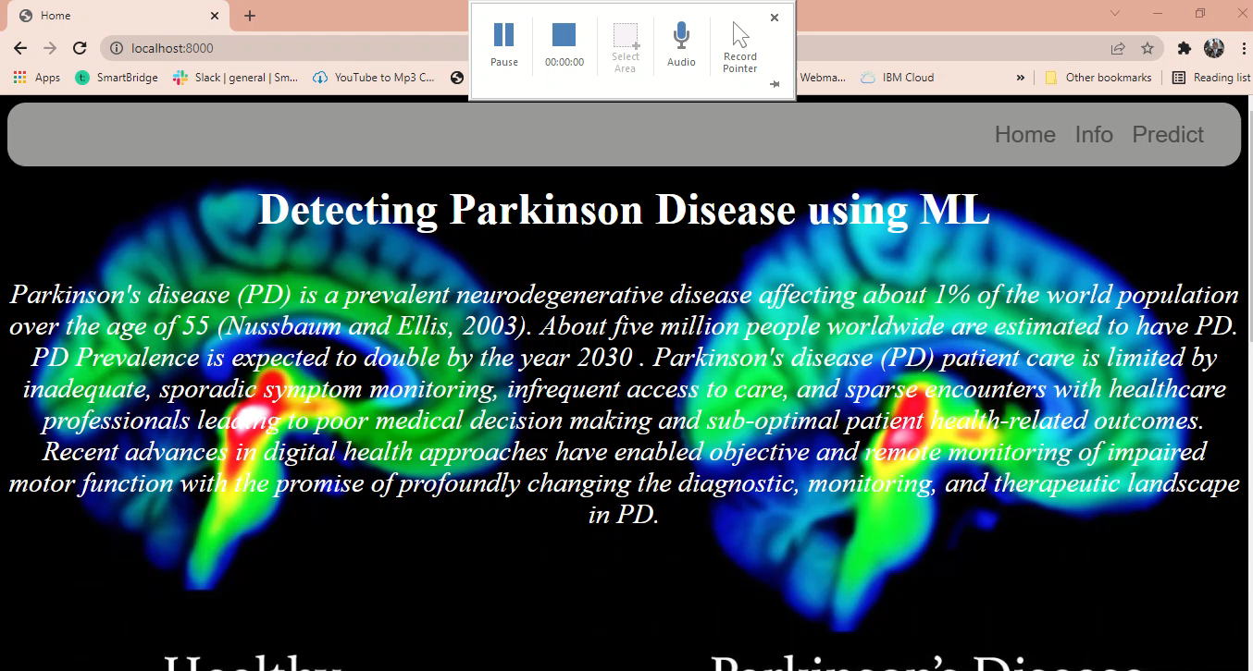

Slide 15
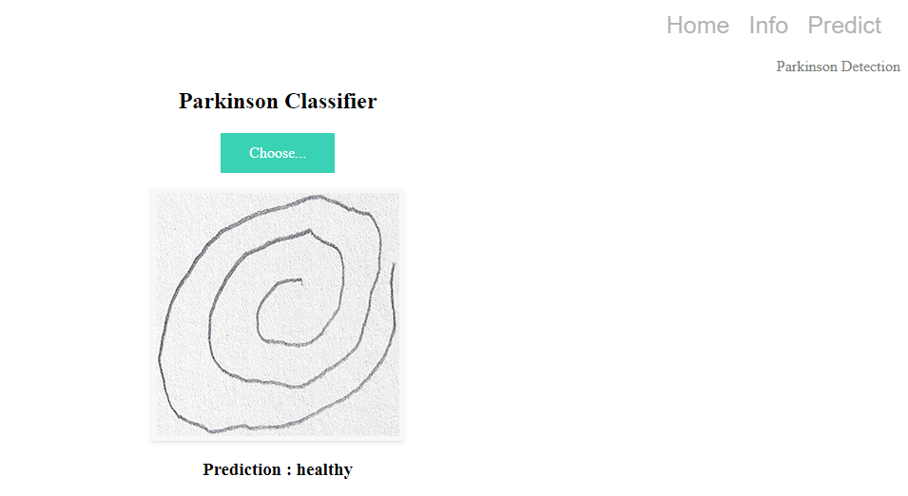
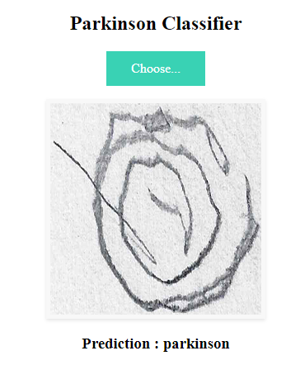
Final output:

Slide 16
THANK YOU….
S SATHVIK
19671A0447
ECE A
JBIET

